Slide 1
MATHs IN ARTS
By Iorga Patricia and Grigoras Flavia

Slide 2
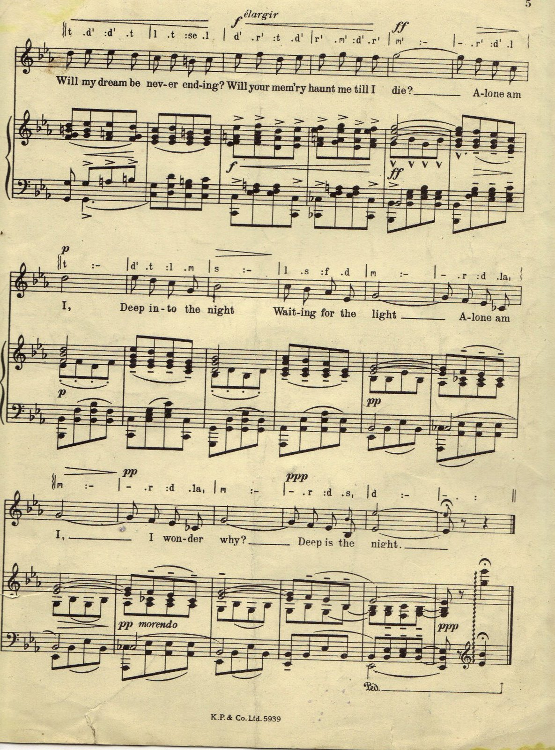
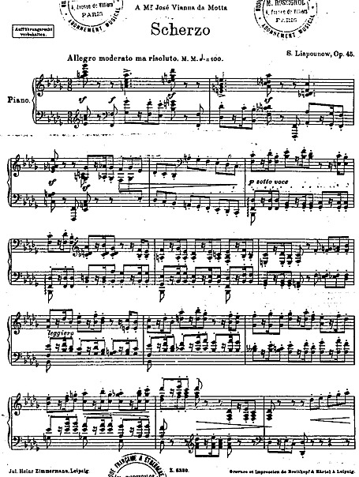
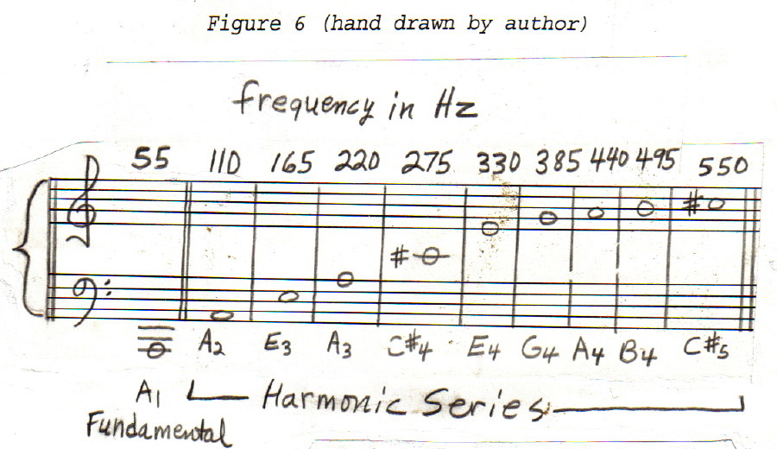
Maths used in music

Slide 3
„Maths is the music of Reason”
What do these two arts have in common?
Maths is the science of numbers and forms, a science that was born from the wish of people to understand and express the world around them. And since sound belongs to this world, it is no wonder that math can be used to describe or build this harmony of sounds called music. Maths is the one that imposes the harmony in a musical piece.

Slide 4
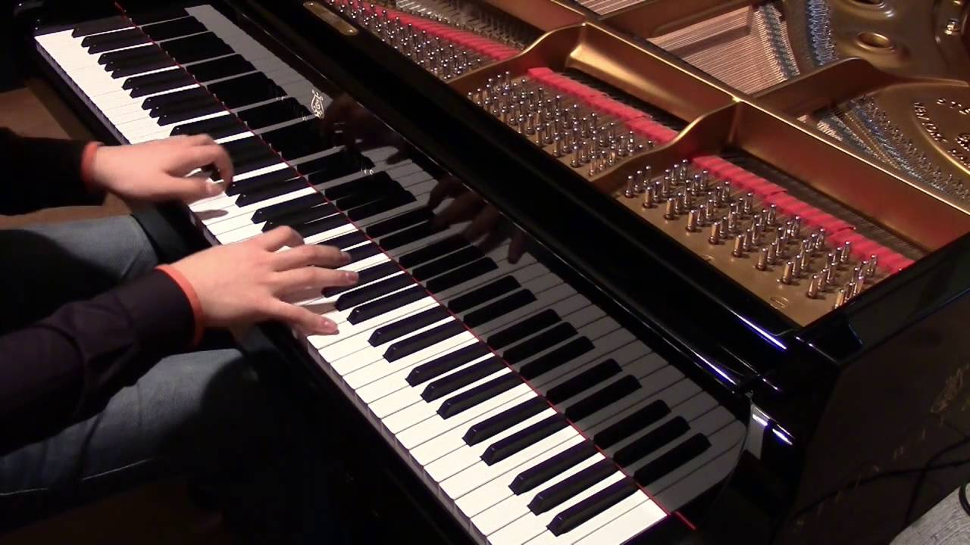
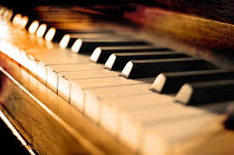

Slide 5
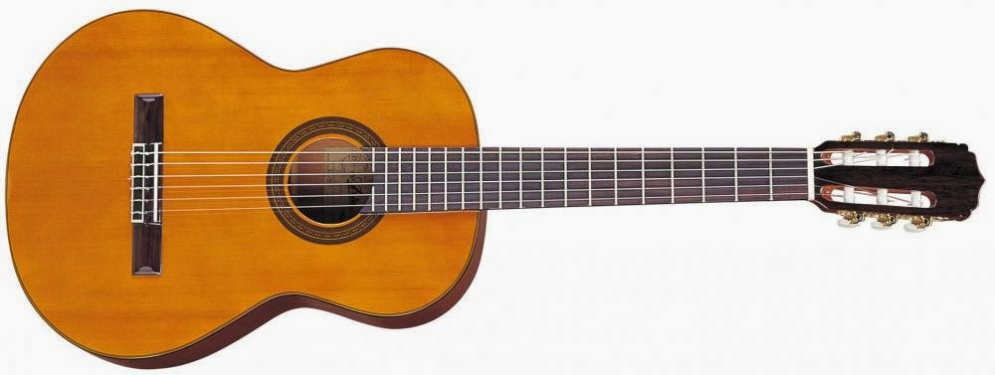
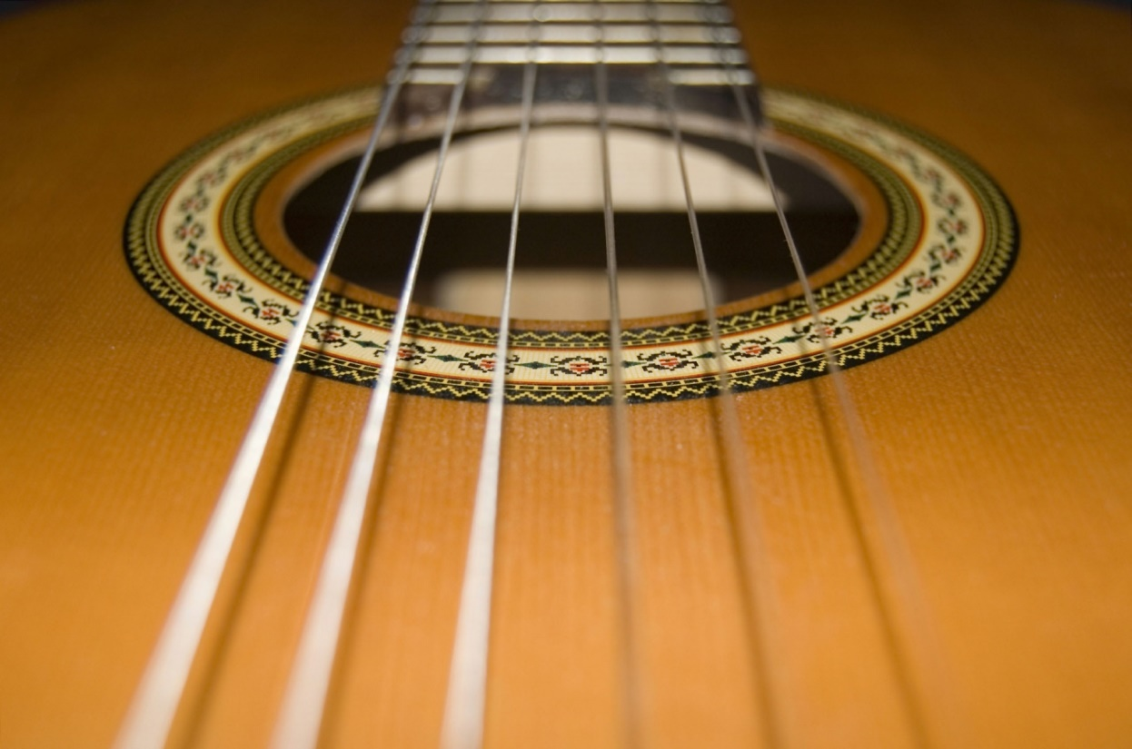

Slide 6
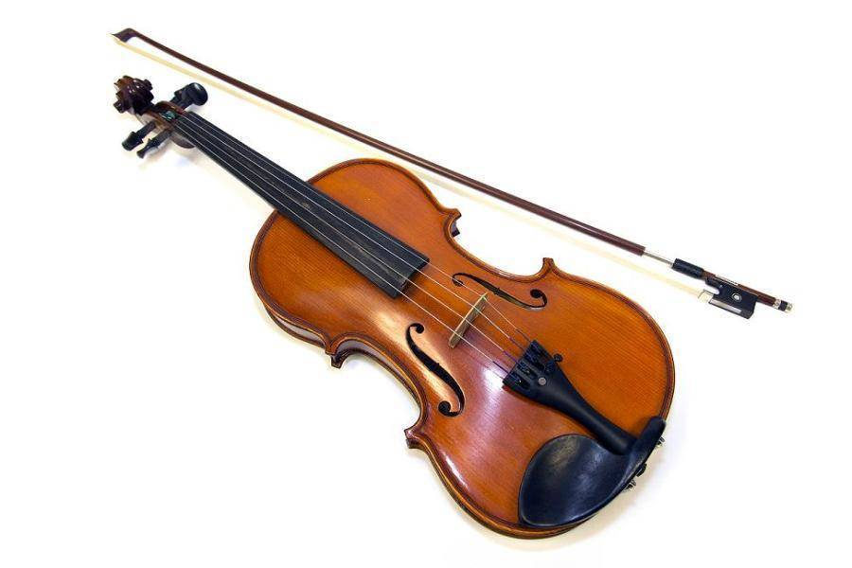
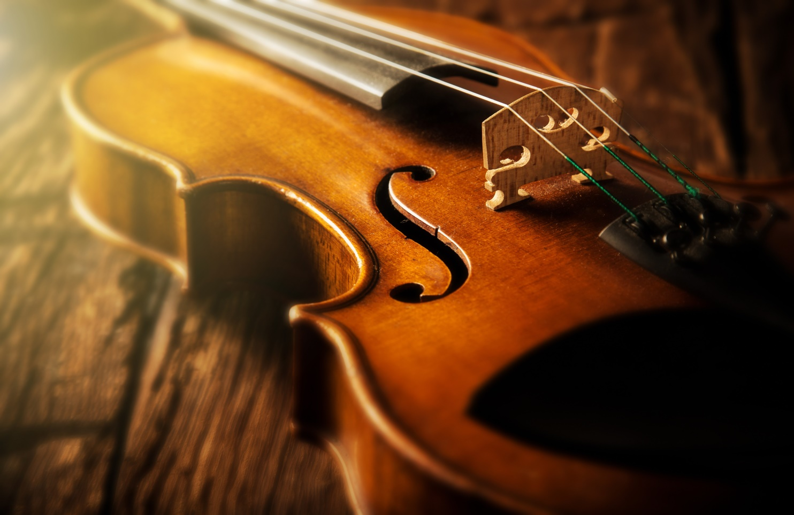

Slide 7

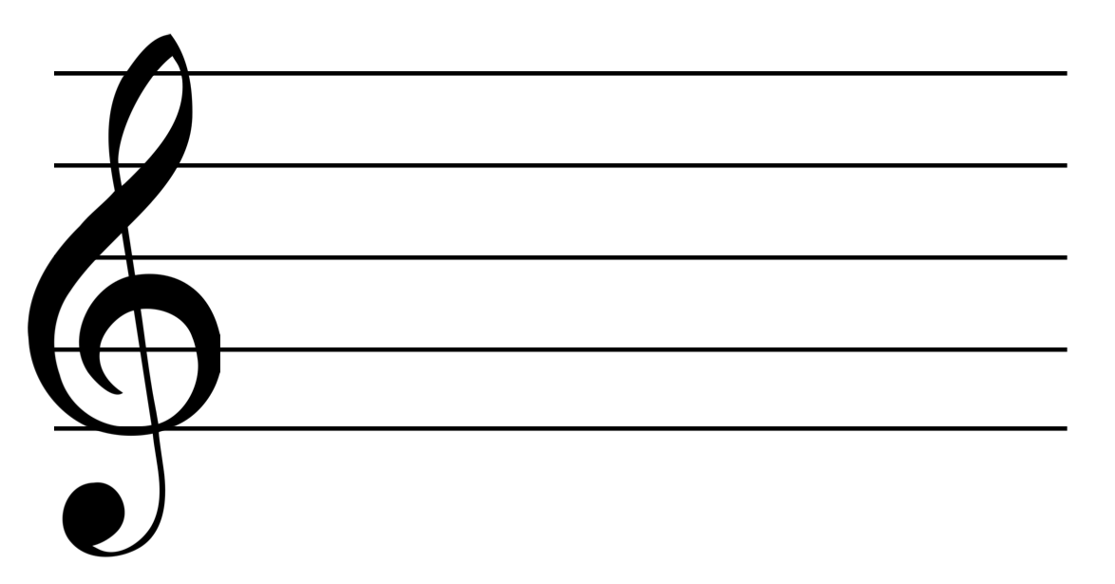
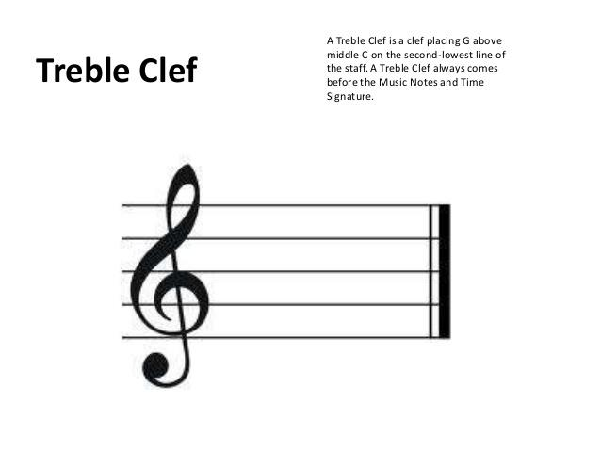


Slide 8
The most important characteristics of music are the rhythm and the tonality
What does rhythm mean?
Tempo and measures play a very important role.
Time signature might be 2/4 (two-four), 3/4 (three-four), 4/4(four-four) and so on.
What does tonality mean?

Slide 9
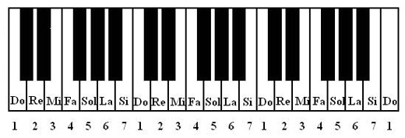
The notes

Slide 10
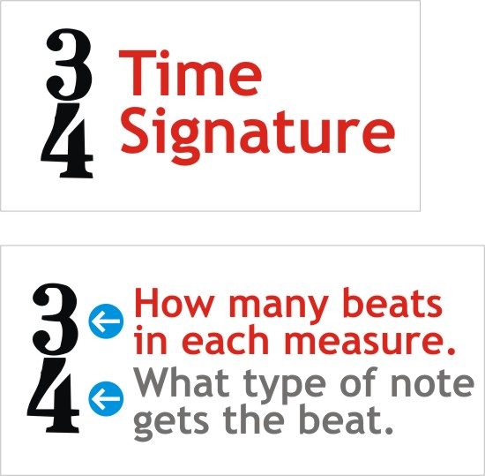
The time signature appears at the beginning of the piece of music, right after the clef symbol and key signature. Most time signatures contain two numbers.

Slide 11
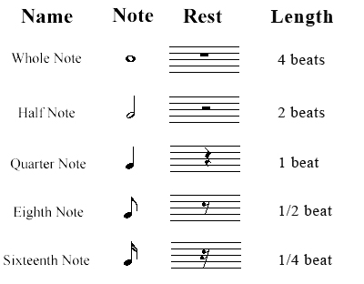
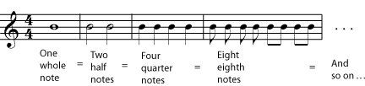

Slide 12
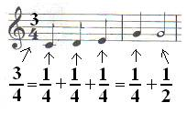
The bond between Math and music has a lot of applications. In fact Math can use concepts like rhythm and measures/bars to pinpoint the bond between multiplication, division and operation with fractions.
For example, in a song with the time signature of 3/4(three-four), the sum of the notes in each measure must be three quarters.

Slide 13
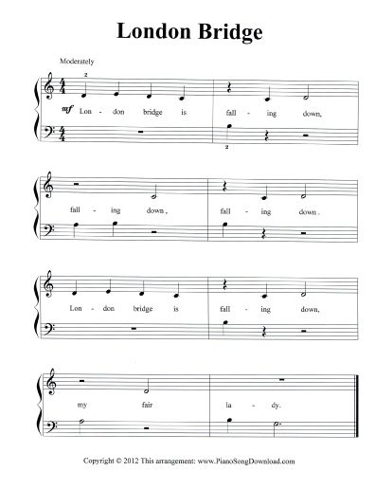

Slide 14
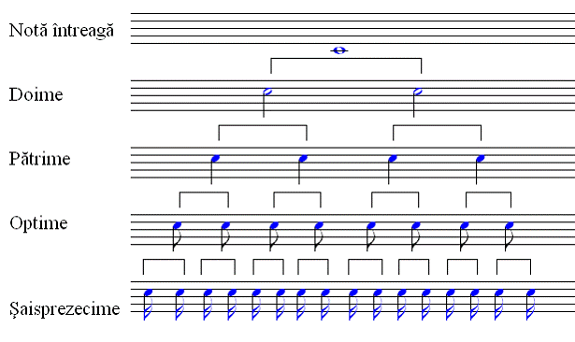
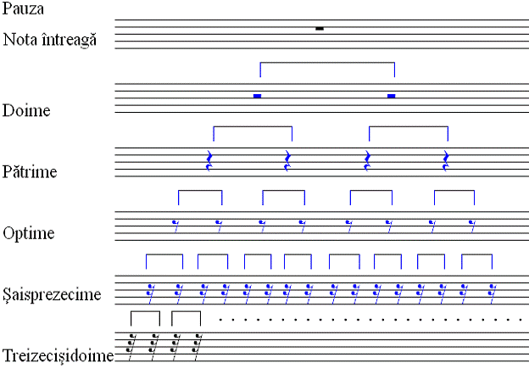

Slide 15
Homework
Portuguese-Knowing the height on the notes fro the value table and from what I explained to you, try to do 3 measures/bars with the time signature of 4/4.
Greeks-Knowing the height on the notes fro the value table and from what I explained to you, try to do 3 measures/bars with the time signature of 3/4

Slide 16
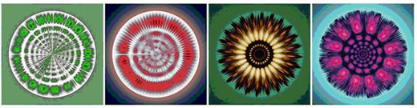

Slide 17
THE END

Slide 18
NOT YET

Slide 19
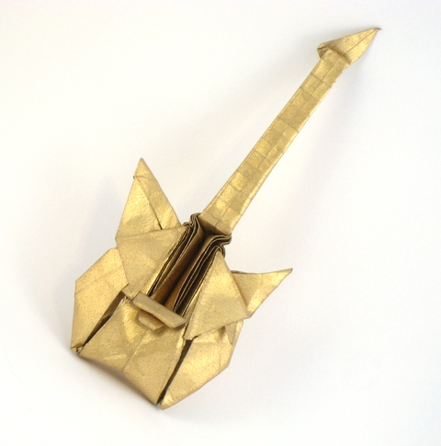
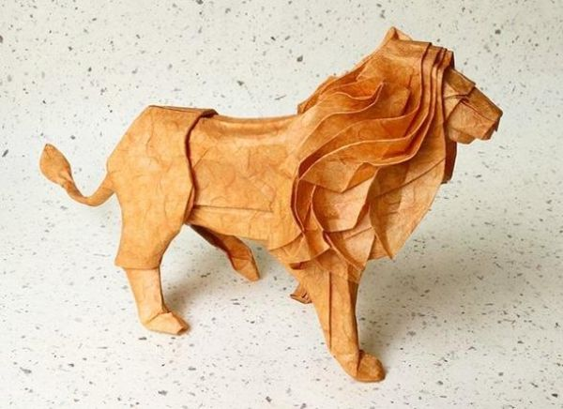
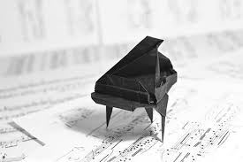
Maths used in origami

Slide 20
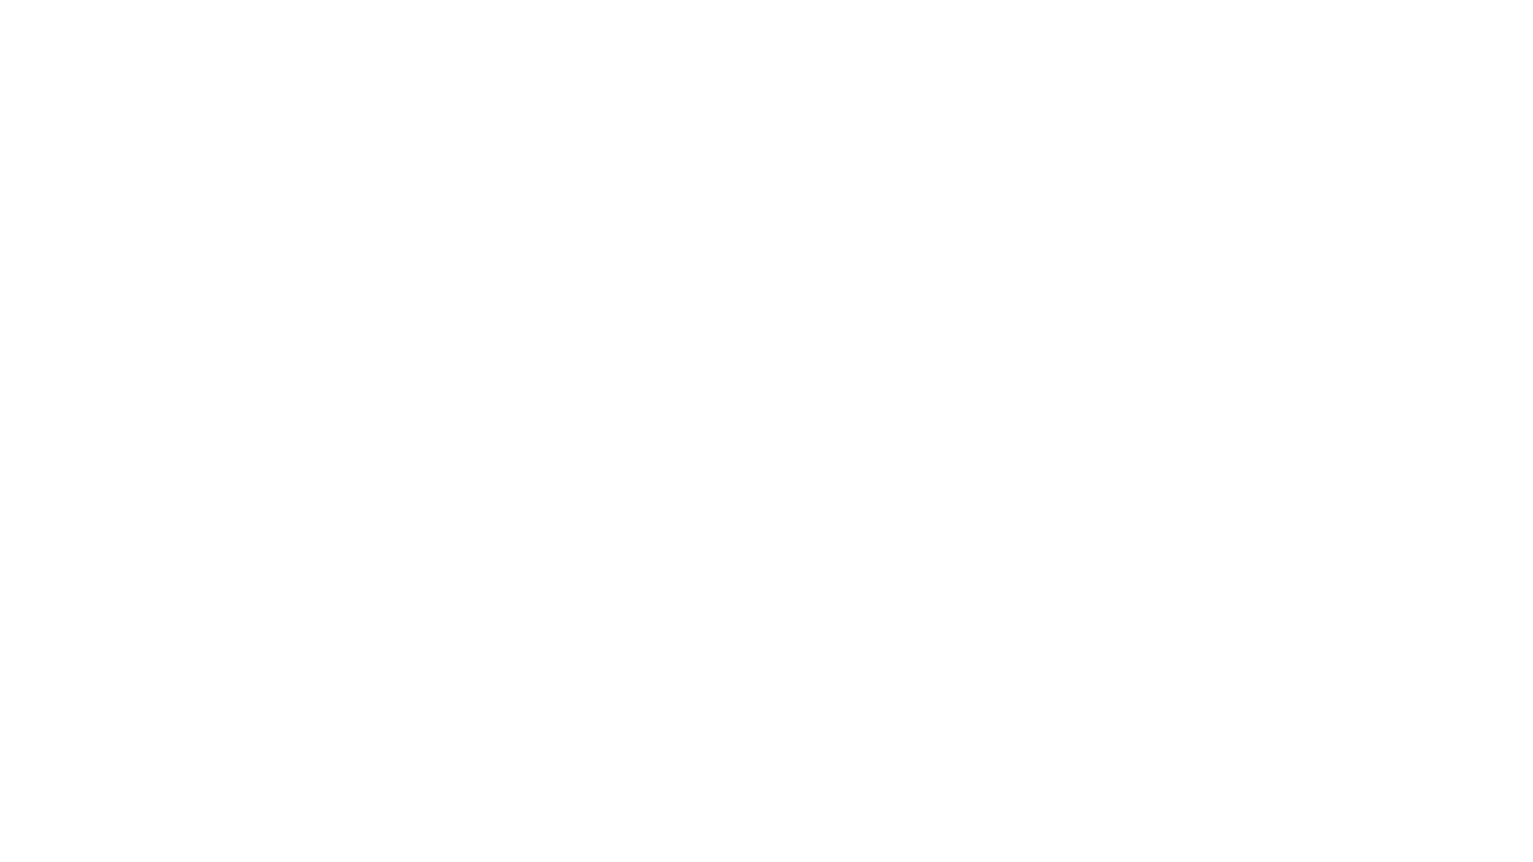
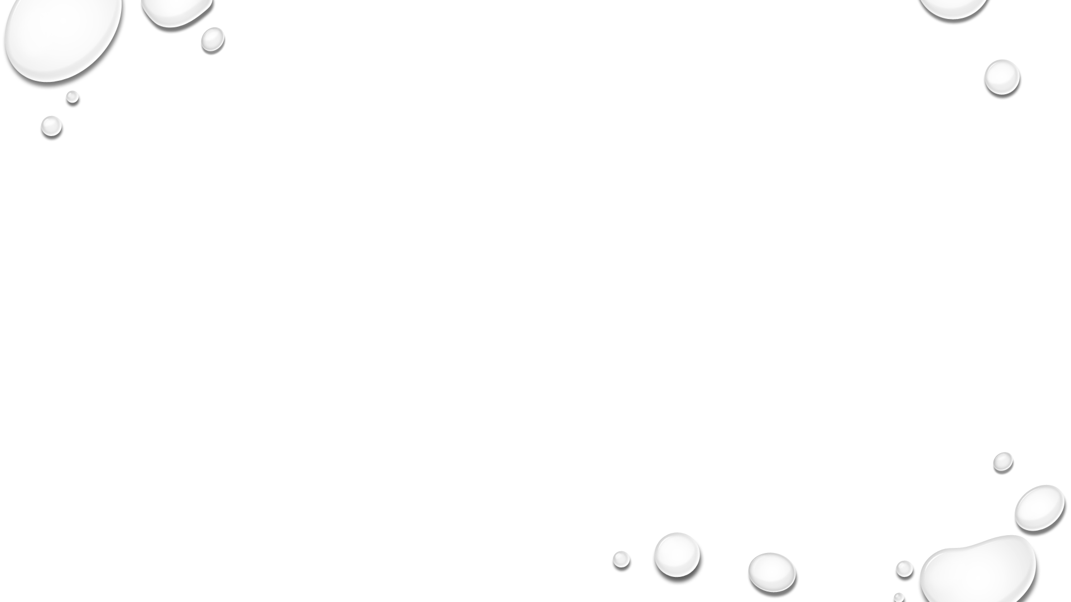
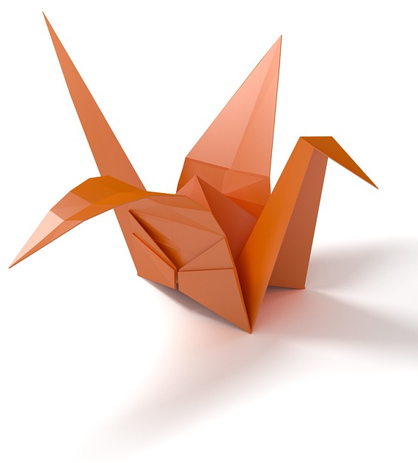
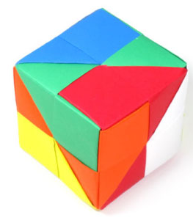
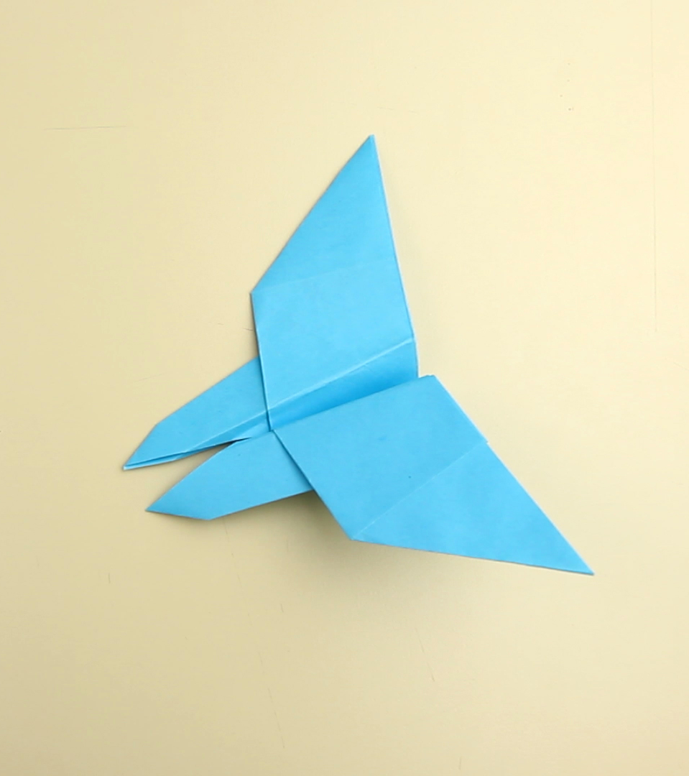
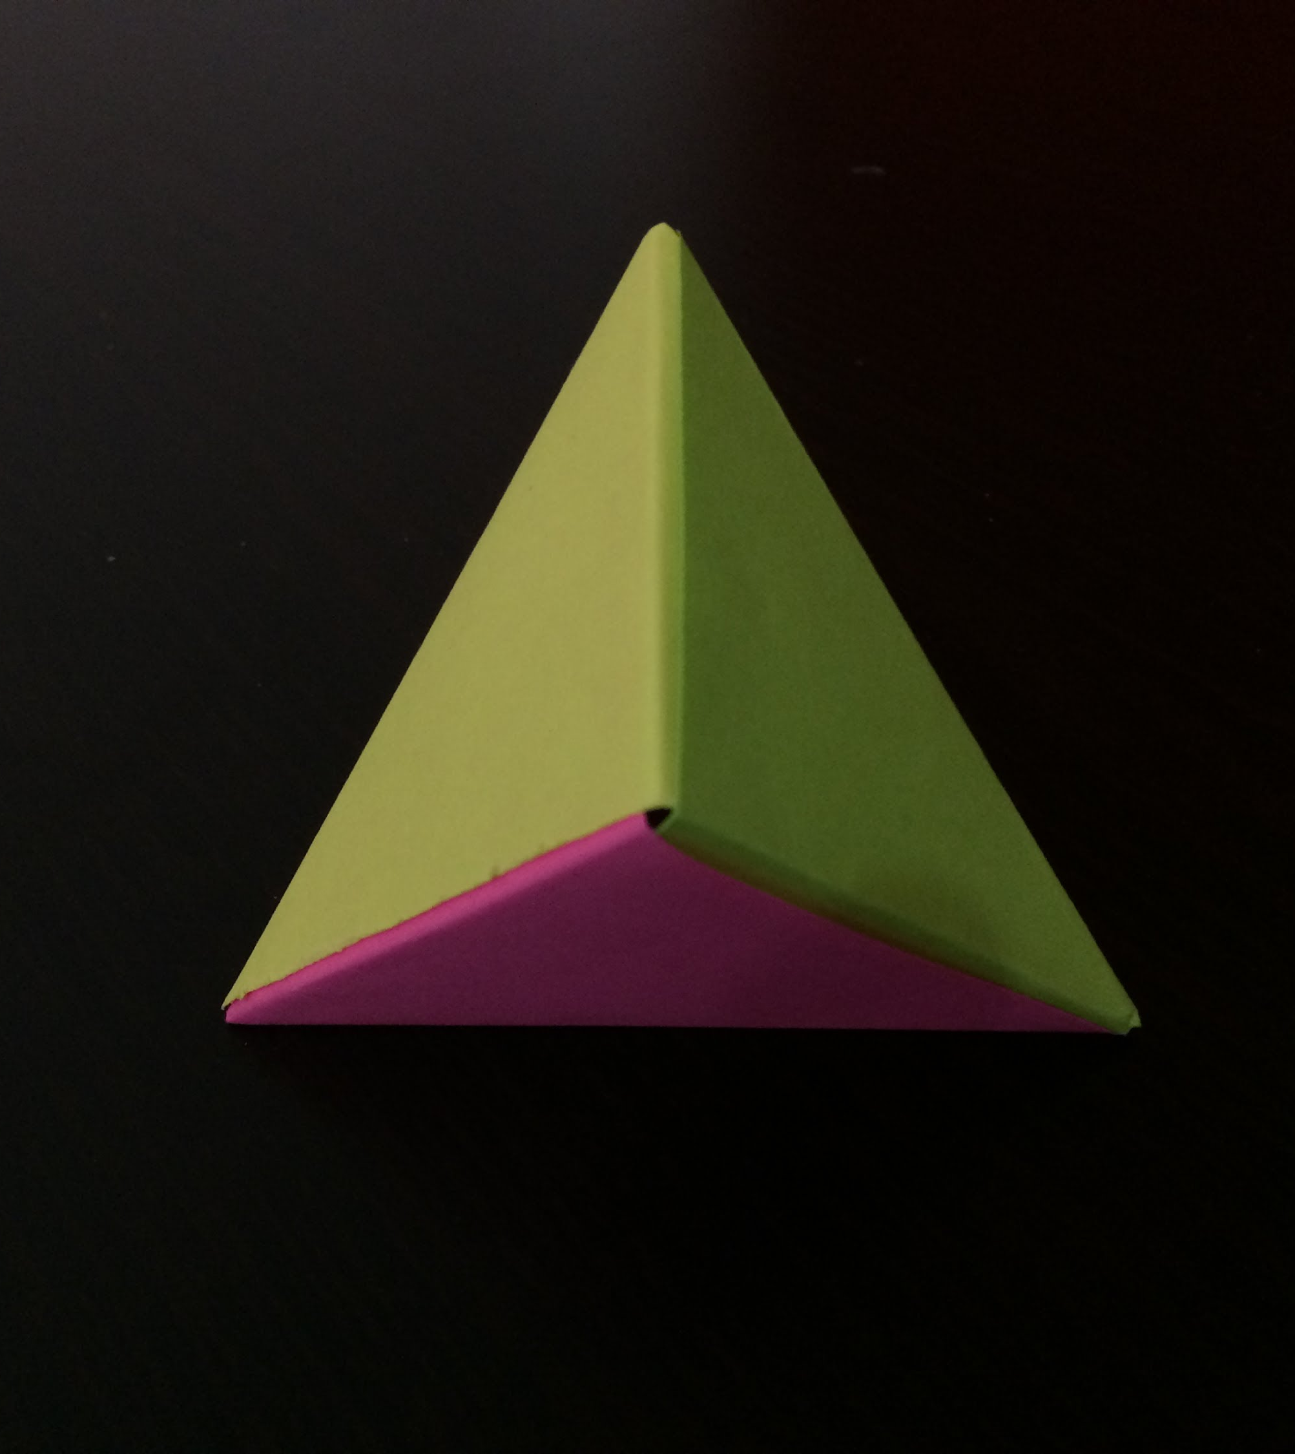
Origami
A lot of you know that origami is the art of folding paper. The connection between maths and origami is simple: geometry.
The MODELS IN THE PICTURES CONSIST OF TRIANGLES AND POLIGONS AND SHOW HOW you CAN CREATE GEOMETRICAL FIGURES FROM ORIGAMI.

Slide 21
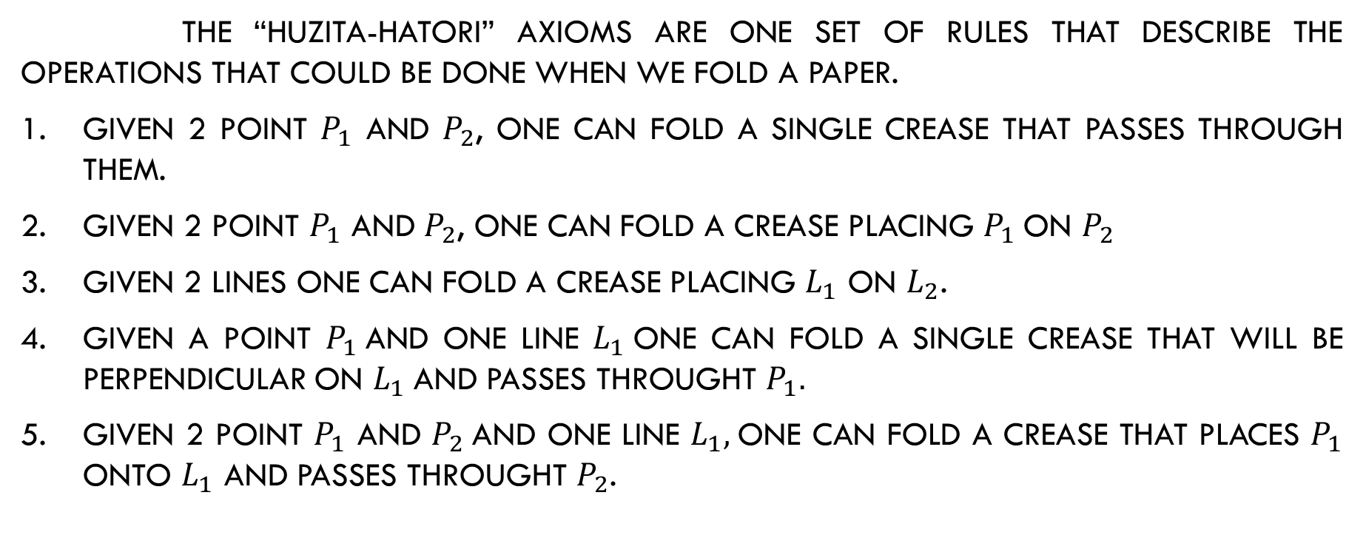
Huzita-Hatori axioms
the “Huzita-Hatori” axioms are one set of rules that describe the operations that could be done when we fold a paper.
Given 2 point $P_{1}$ and $P_{2}$, one can fold a single crease that passes through them.
Given 2 point $P_{1}$ and $P_{2}$, one can fold a crease placing $P_{1}$ON $P_{2}$
GIVEN 2 LINES one can fold a crease placing $L_{1}$ on $L_{2}$.
Given A point $P_{1}$and ONE LINE $L_{1}$one can fold a single crease that WILL BE PERPENDICULAR ON $L_{1}$AND PASSES THROUGHT $P_{1}.$
Given 2 point $P_{1}$ and $P_{2}$AND ONE LINE $L_{1},$one can fold a crease THAT PLACES $P_{1}$ ONTO $L_{1}$ AND PASSES THROUGHT $P_{2}$.

Slide 22
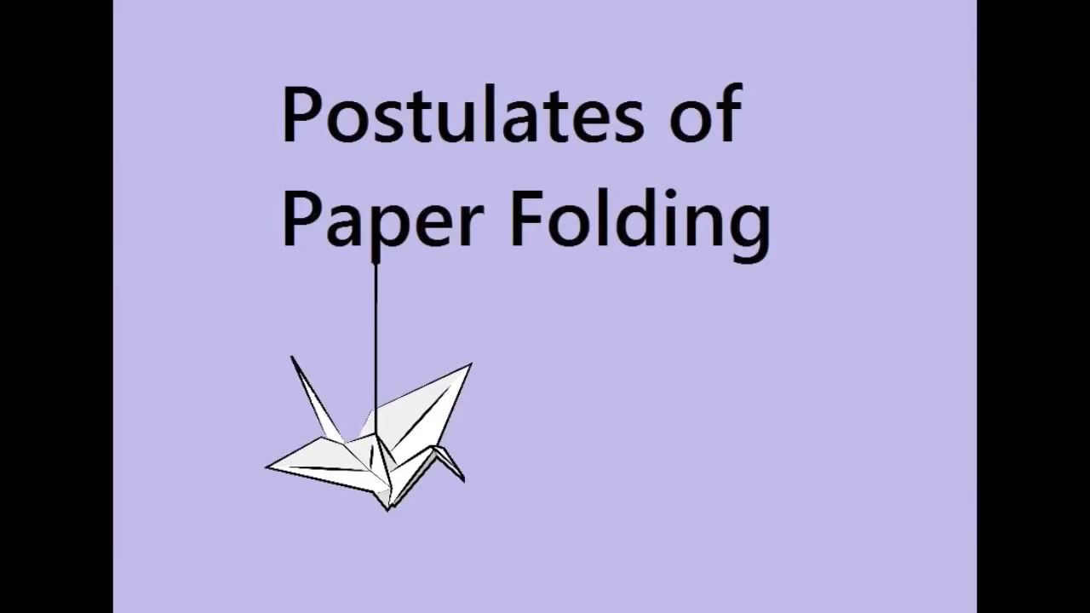

Slide 23
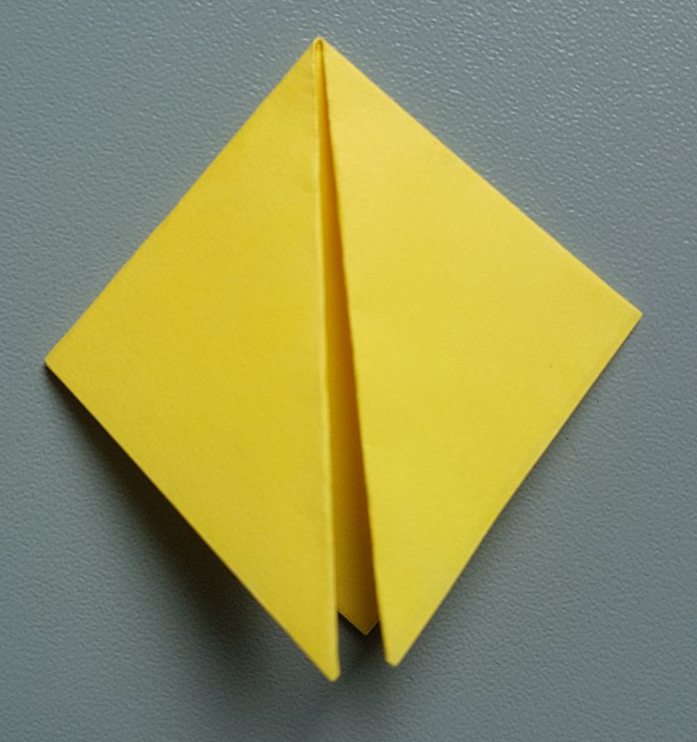
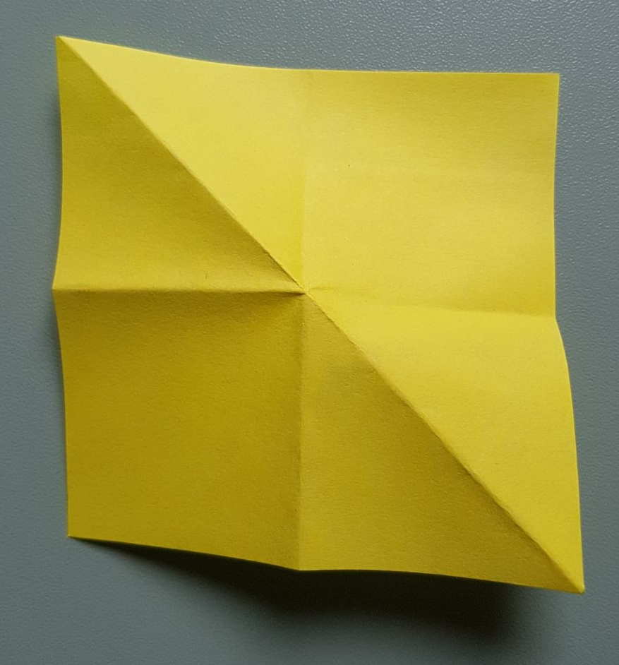
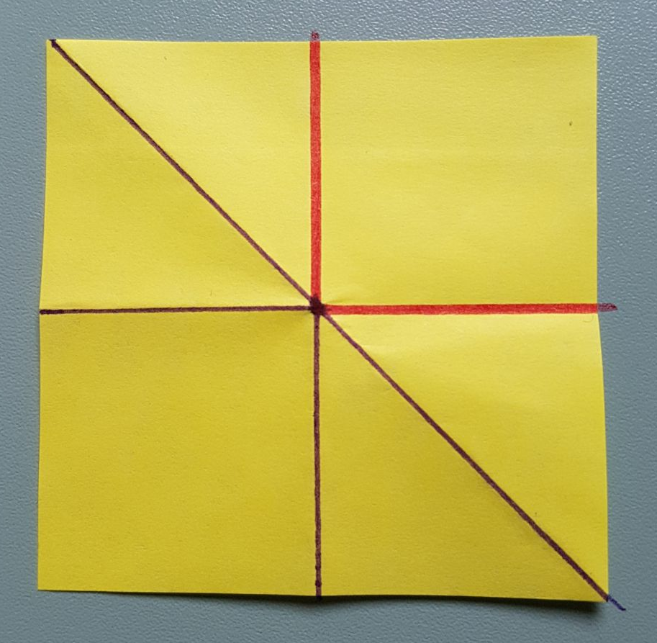


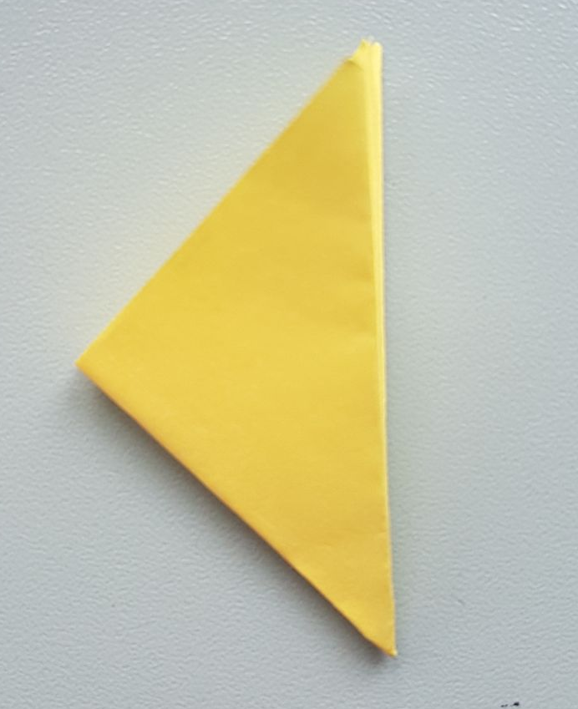
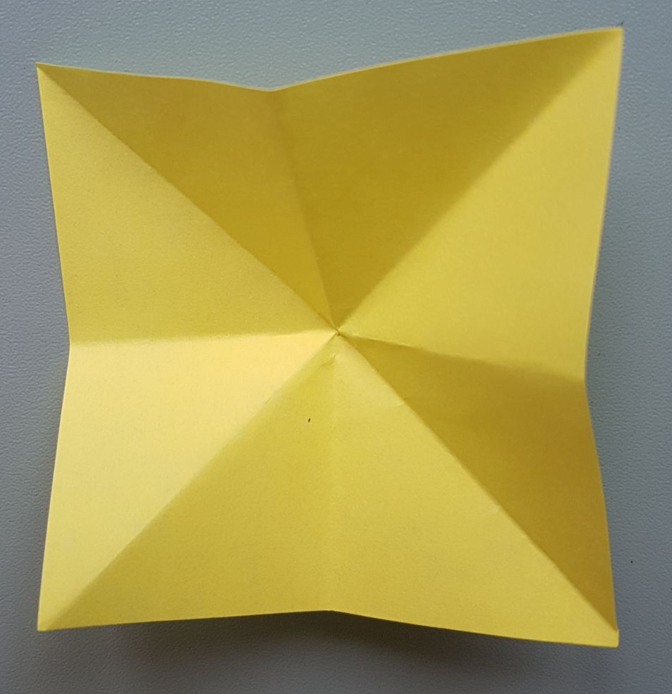
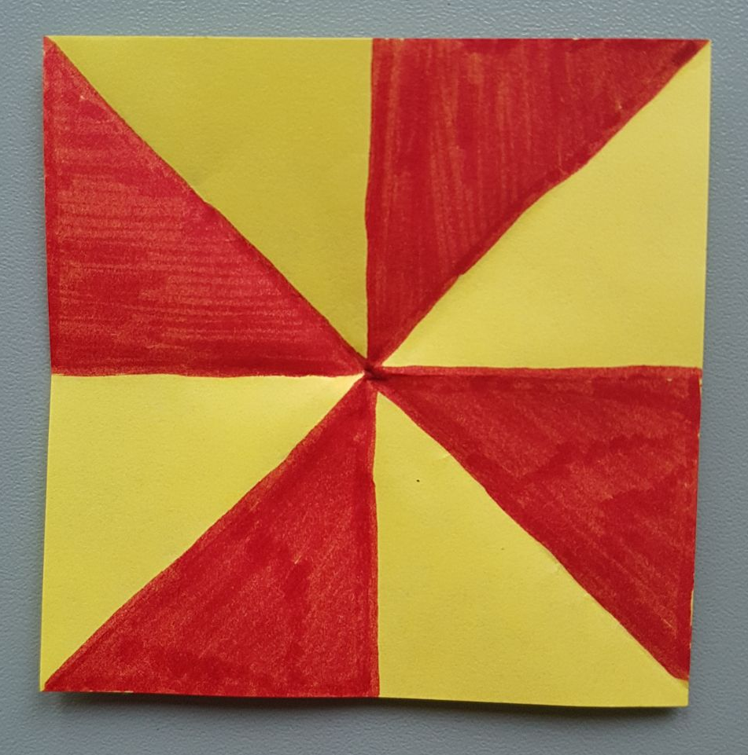

Origami’s theorems
Maekawa THEOREM: THE MODULE OF DIFFERENCE BETWEEN NUMBER OF FOLDs IN MOUNTAIN AND VALEYs is 2 .
Kawasaki THEOREM: the sumM of all the angles without pairs is 180.

Slide 24
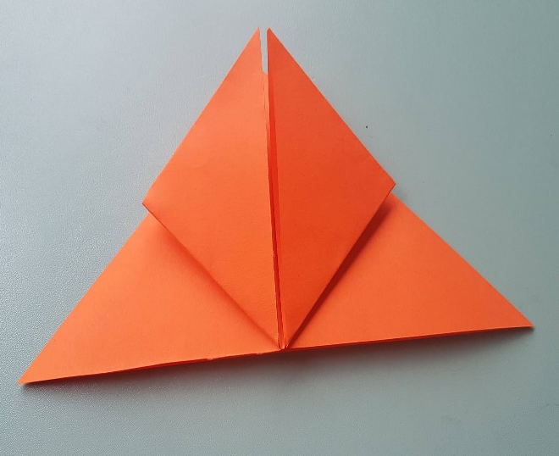
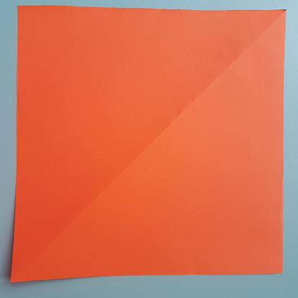
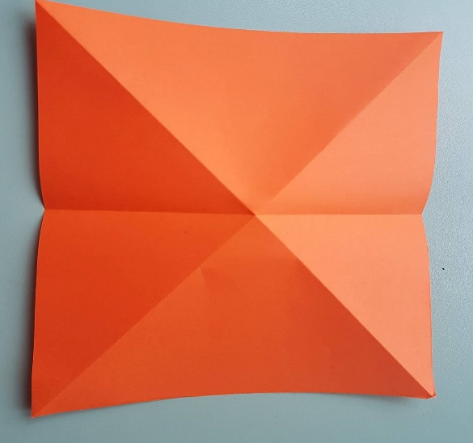
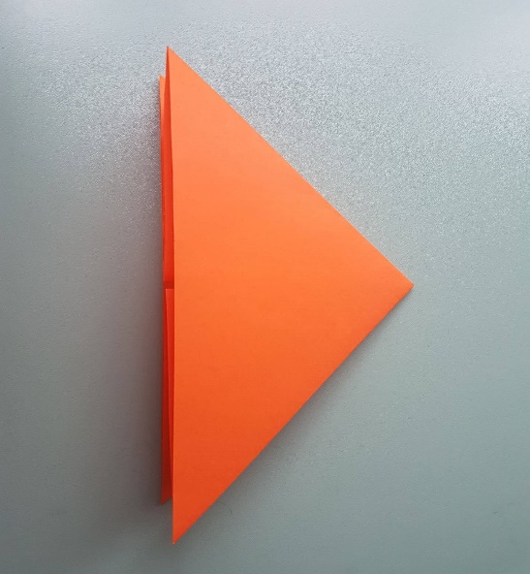
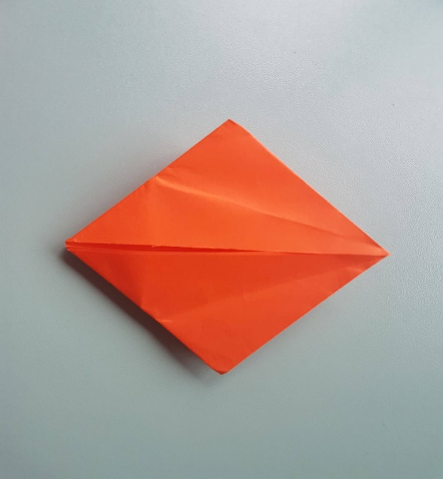
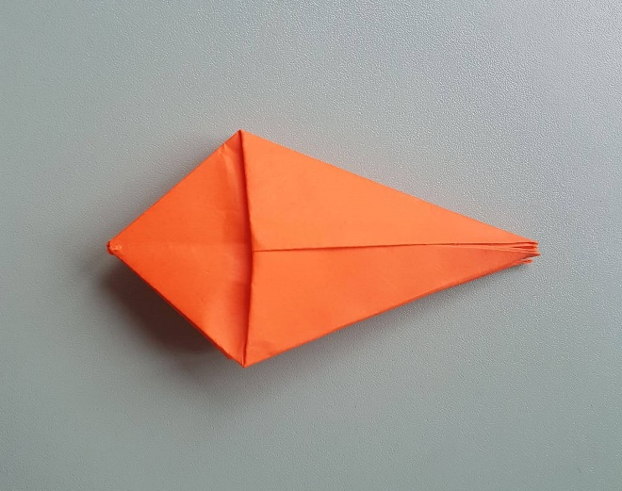
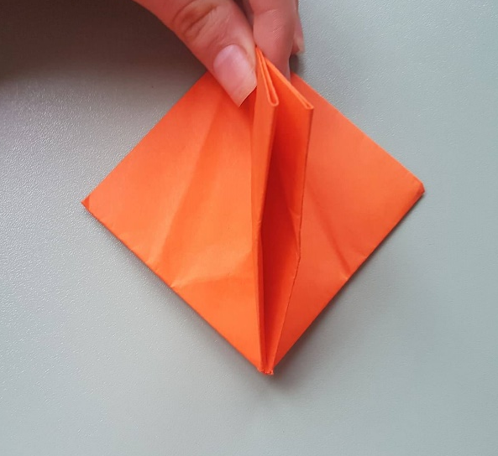
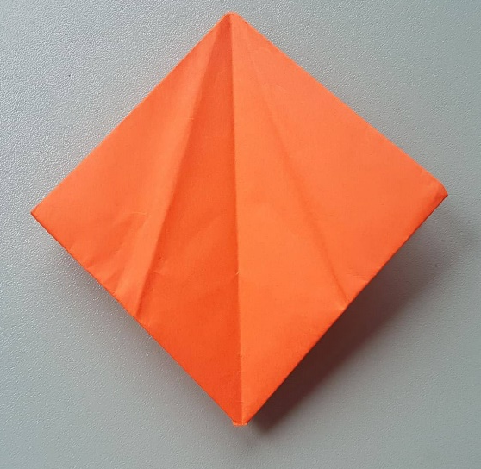
homework 1 how to make a tulip
1.
4.
2.
3.
5.
8.
6.
7.

Slide 25
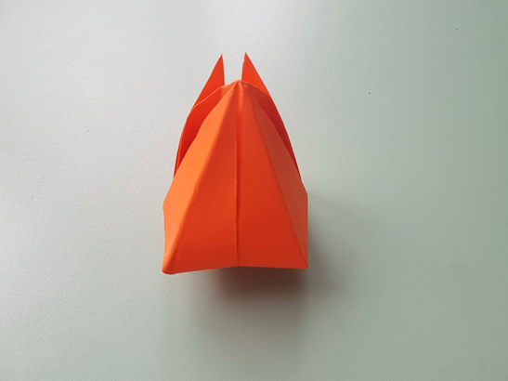
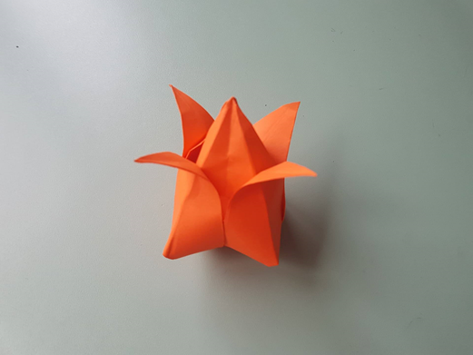
9.
10.

Slide 26
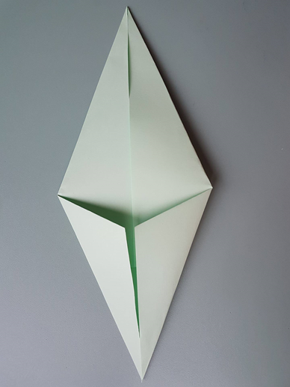
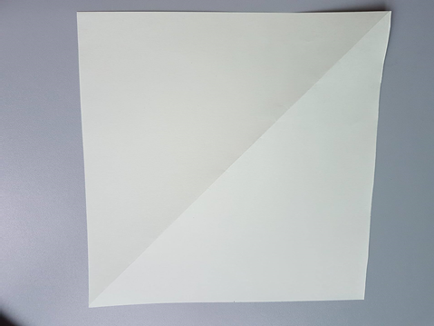
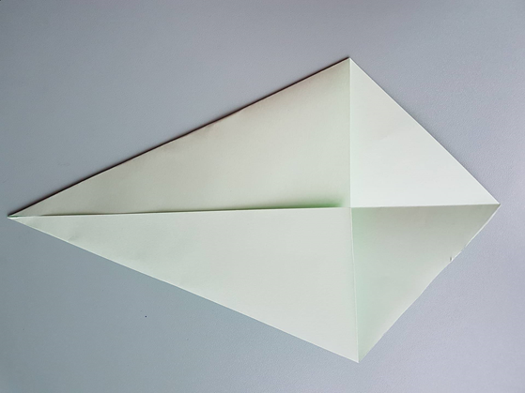




1.
3.
2.
4.
7.
5.
6.

Slide 27


Slide 28


Slide 29
Homework 2
Demonstrate why the point find in the video is at 1/3 from BC? The surface of the square is 1x1.
A
B
G
E
D
F
C
x
1-x

