Slide 1
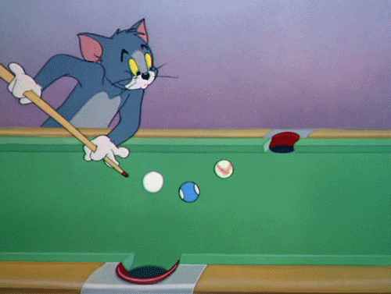
MATHS IN SPORTS..?
AZGUR

Slide 2
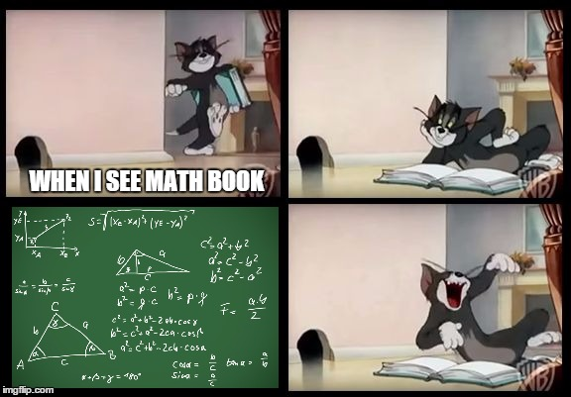

Slide 3
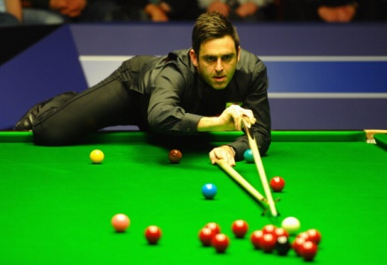
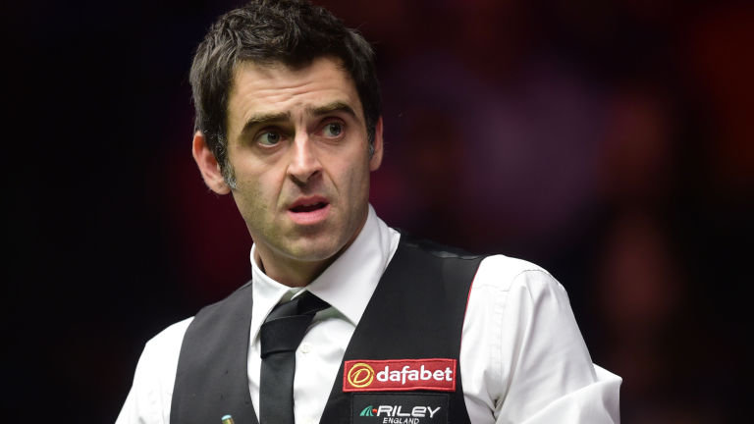
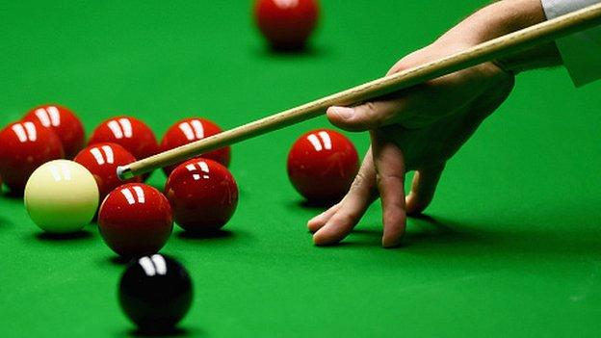

SNOOKER

Slide 4






HISTORY…
Snooker is a cue sport which originated among British Army officers in Etawah, India in the latter half of the 19th century.
Snookerul is very popular in countries that speak English (UK, Ireland, Canada, Australia, India și South Africa).

Slide 5
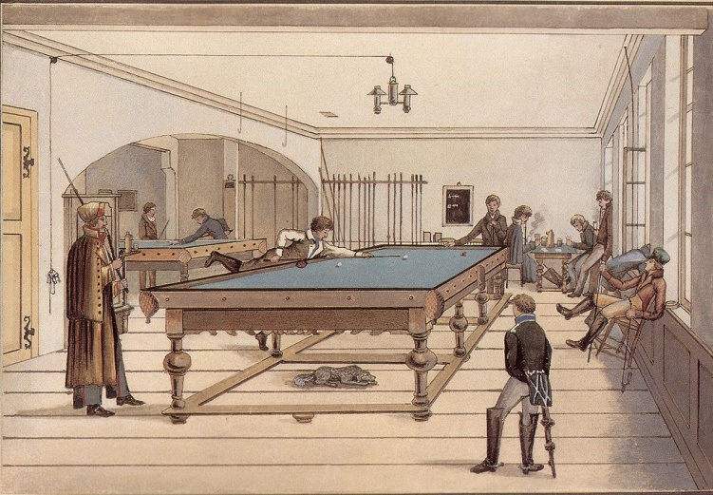
1800

Slide 6
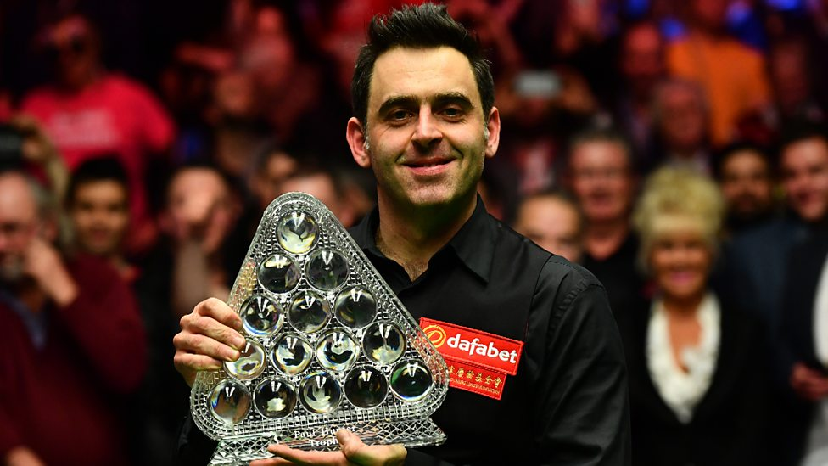
RONNIE O’SULLIVAN

Slide 7
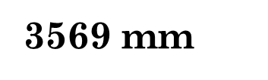
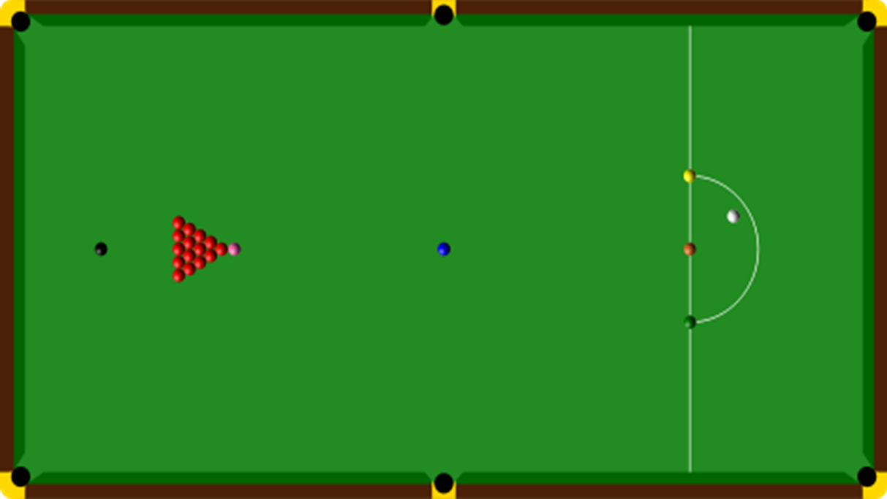


Snooker is played on a rectangular table , 3569 mm x 1778 mm. The table has 6 built-in pockets, at the corners and middles of both long edges.

Slide 8
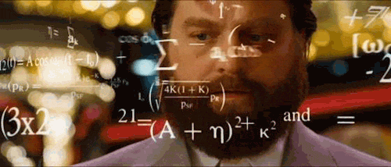
QUESTION 1
Calculate the area of the table.

Slide 9
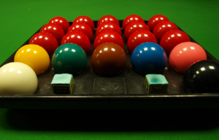
On the table are placed, at the start of every game, 22 balls. There are:
15 red balls;
6 balls, named colorful balls, which are: a yellow one, a green one, a brown one, a blue one, a pink one, and a black one.
A white ball

Slide 10





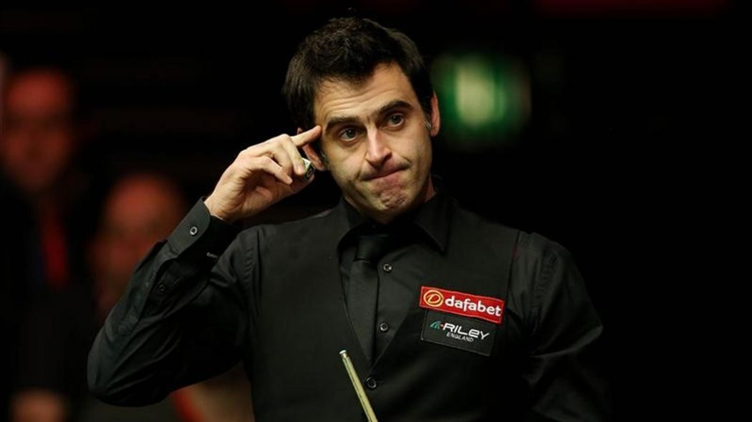




QUESTION 2
1
8
5
6
54
14
2

Slide 11
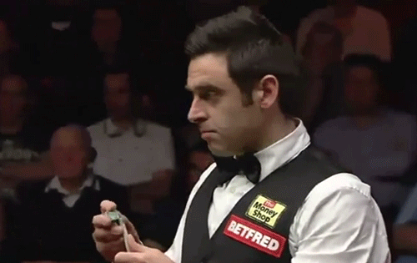
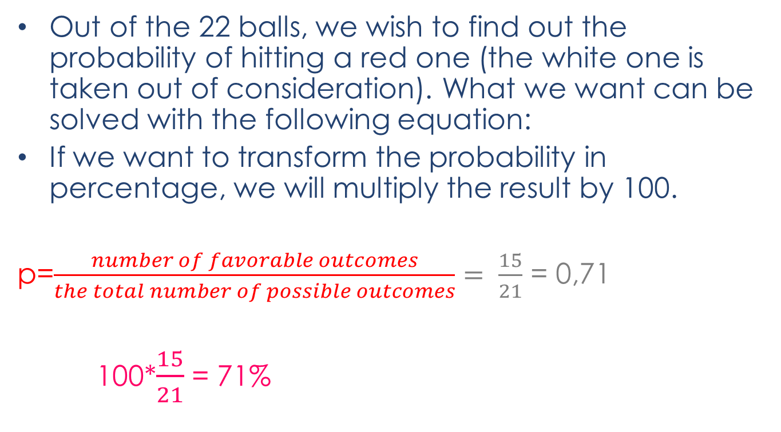
PROBABILITY
Out of the 22 balls, we wish to find out the probability of hitting a red one (the white one is taken out of consideration). What we want can be solved with the following equation:
If we want to transform the probability in percentage, we will multiply the result by 100.
p=$\frac{number of favorable outcomes}{the total number of possible outcomes}= \frac{15}{21}$ = 0,71
100*$\frac{15}{21}$ = 71%

Slide 12
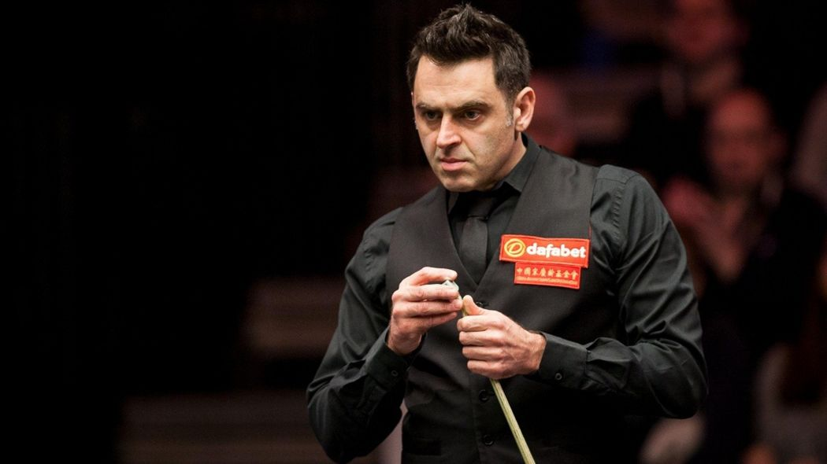
QUESTION 3
What is the probability of hitting a colorful ball? Transform the result into percentages.

Slide 13
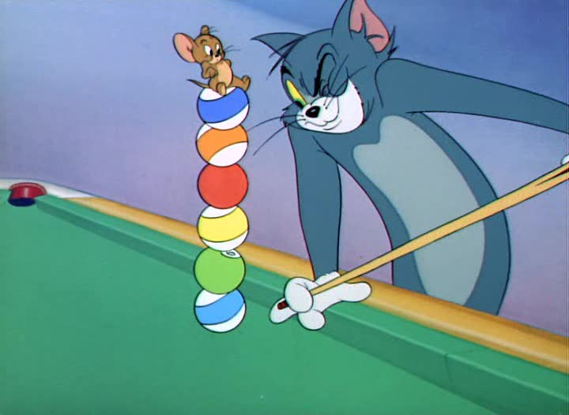

Slide 14
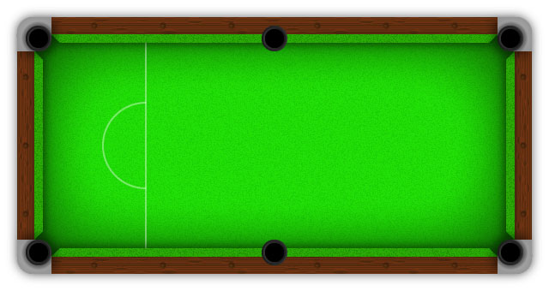




QUESTION 4
60º
?
1791 mm

Slide 15
COSTS VS EARNINGS
COSTS:
renting the venue
the players’ wages
the value of the prizes
media coverage
Earnings:
tickets
publicity
television copyrights

Slide 16

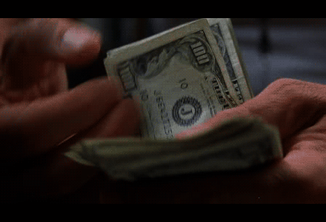
COSTS
renting the venue: 5.000 euros
the players’ wages: 40.000 euro
First prize: a trip to Maldives + 18.000 euros
second prize: a 3-day-trip to France+ 5.000 euros
media coverage: 1000 euros

Slide 17
EARNINGS
television copyrights: 60.000 euro
publicity: 45.000 euro
----------------------------------------------
tickets: x euro to cover the costs
The capacity of the venue: 2.000 places
VIP tickets: 920 euro (100 available)
Normal tickets: 200 euro
Spectators: 1500 VIP(85): 78.200 euro
normal(1415): 283.000 euro

Slide 18
EARNINGS
60.000+
45.000
361.200
-------------
466.200 euro
COSTS
5000+
40.000
40.000
18.000
5.000
1.000
----------------
109.000 euro
Profit:
466.200-109.000= 357.200 euro

Slide 19
QUESTION 5
Calculate the price of one ticket knowing that:
renting the venue costs 9.500 euro (3.000 places)
the players’ wages : 40.000 euro
Prizes: 30.000 euro
television copyrights 45.000 euro
publicity: 28.000 euro

